Slide 1
Computer Assited Reviewers for PPI

Slide 2
Why are we doing it?
To develop an objective assessment of Patient Information Leaflets (PILs) quality.
To assess how much effect PILs have on the patients informed decision.
To measure the association between PIL quality and patients’ interest and understanding of Randomized Controlled Trials (RCTs).

Slide 3
How are we doing it?
First Phase
Create a web system that links the relevant information:
Text in the leaflet
Specific comments of leaflet sections
Global comments on the leaflet
Reviewer quality grade
Reviewer understanding
Reviewer demographics
RCT recruitment
Second Phase
Employ Web analysis techniques to discover associations:
Employ clustering analysis to find patterns of interest that correlate with recruitment or understanding.
Employ content analysis to obtain objective assessment of the comments

Slide 4
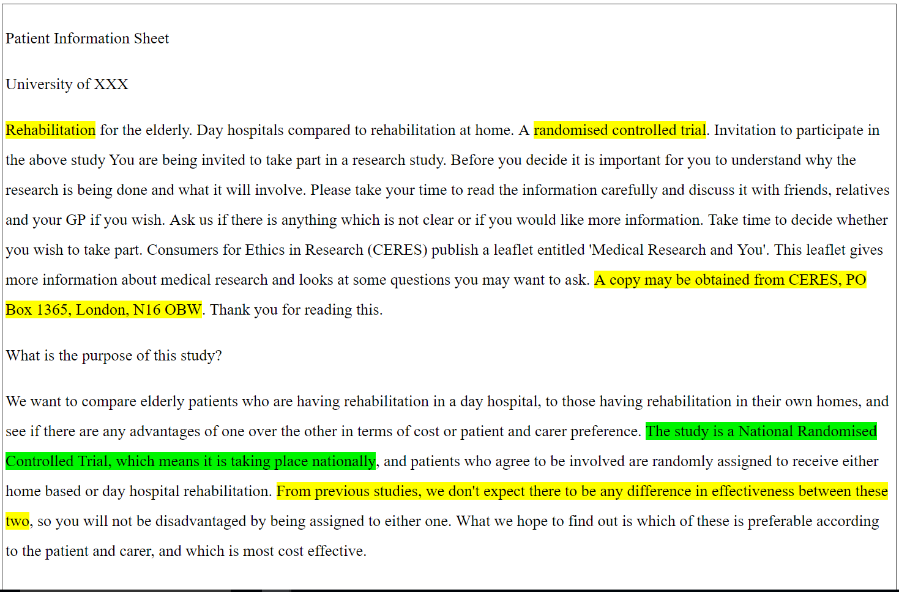
The CARPI System
Computer Assited Reviewer for PPI (CARPI) is the base for our analysis.

Slide 5
WHAT IS IN THE SYSTEM
25 PARTICIPANTS
Reviewed each leaflet
Gave specific or general comments on each leaflet
Graded the quality of the leaflet
Answered a quiz about the information in the leaflet (EQIP)
4 LEAFLETS FOR POOR RECRUITING INTERVENTIONS OF LOW-RISK TRIALS
Rehabilitation at home or in hospital
Knee surgery for treating osteoarthritis
Treatment of varicose veins
Treatment of constipation

Slide 6
RESULTS
OBTAINED:
85 Global comments
159 Specific comments
Significant correlation between age group and quality grades
Significant correlation between the education level and the percentage of correct answers

Slide 7
WHO WAS OUR SAMPLE?

Slide 8
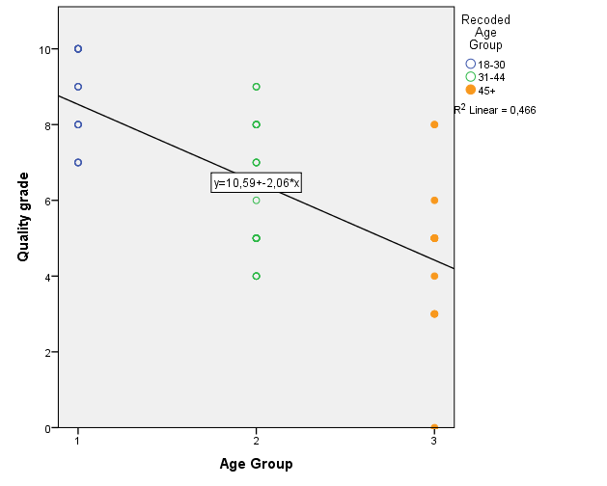
RELATION BETWEEN AGE GROUP AND QUALITY GRADES

Slide 9
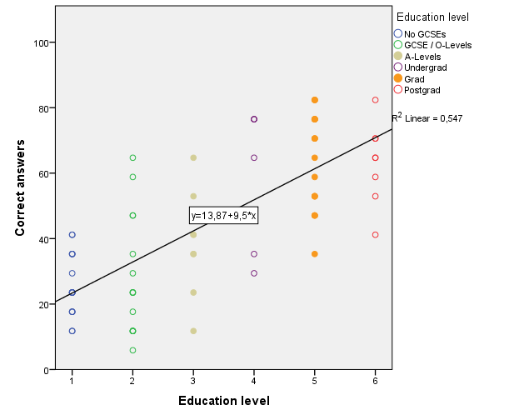
RELATION BETWEEN EDUCATION LEVEL AND CORRECT ANSWERS

Slide 10
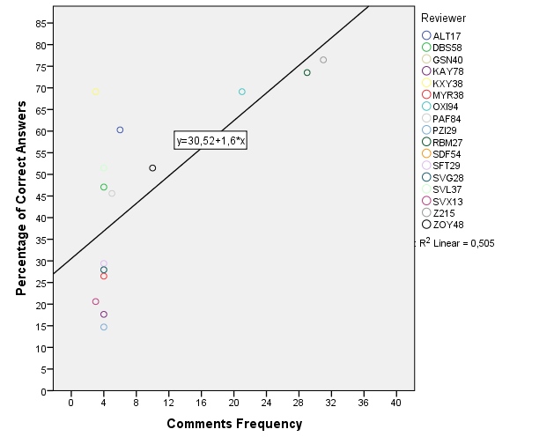
RELATION BETWEEN COMMENTS & CORRECT ANSWERS

Slide 11
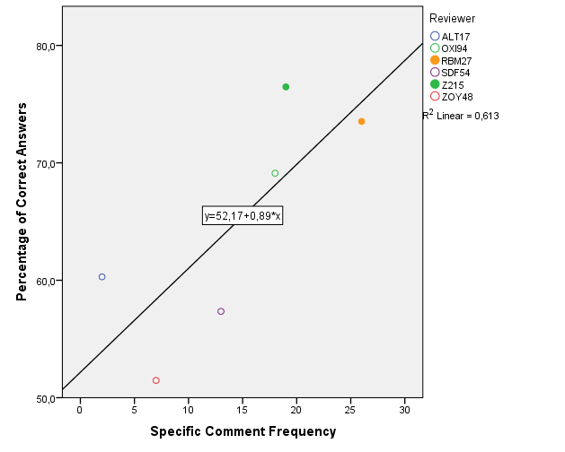
SPECIFIC COMMENTS AND CORRECT ANSWERS

Slide 12
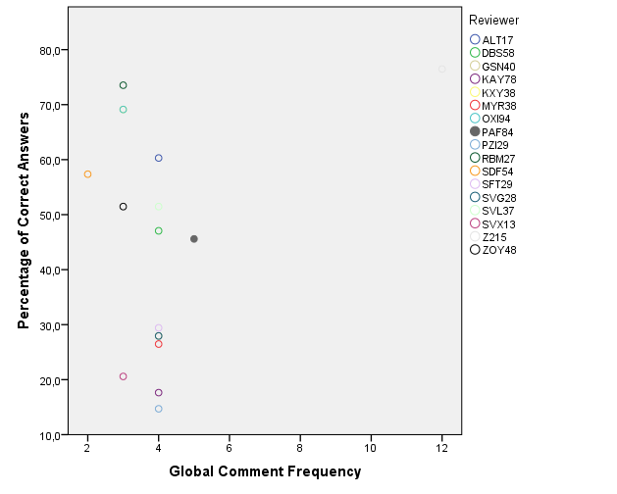
NON-SIGNIFICANT CORRELATIONS

Slide 13
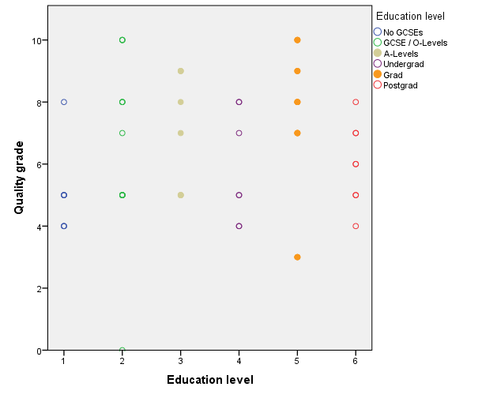
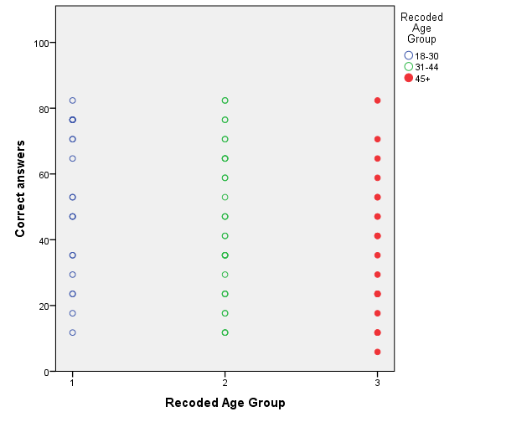
NON-SIGNIFICANT CORRELATIONS

Slide 14
CONCLUSIONS
Only 40% of the participants gave specific comments about the leaflets
The amount of global comments doesn’t correlate with the assigned grades or the correct answers.
The leaflet readability cannot be determined by only taking into account general comments or qualitative quality measures.

